Slide 1

The Sparks Foundation
Data Science & Business Analytics Intern
TASK – 1 : Prediction Using Supervised Learning (Linear regression)
Author : Sagar Kishore Dakua

Slide 2
Prediction Using Supervised ML
Machine Learning: Linear regression
Language: Python
IDE: Jupyter Notebook
Libraries: Pandas, NumPy, Scikit Learn, Matplotlib

Slide 3
Linear regression in Machine Learning
Definition:
Linear regression is a linear approach for modelling the relationship between a scalar response and one or more explanatory variables. The case of one explanatory variable is called simple linear regression; for more than one, the process is called multiple linear regression.
Linear regression is a linear model, e.g. a model that assumes a linear relationship between the input variables (x) and the single output variable (y). More specifically, that y can be calculated from a linear combination of the input variables (x).

Slide 4
Uses & Applications of Linear regression
Marks scored by students based on number of hours studied. Here marks scored in exams are independent and the number of hours studied is independent.
Predicting crop yields based on the amount of rainfall. Yield is a dependent variable while the measure of precipitation is an independent variable.
Predicting the Salary of a person based on years of experience. Therefore, Experience becomes the independent while Salary turns into the dependent variable.

Slide 5
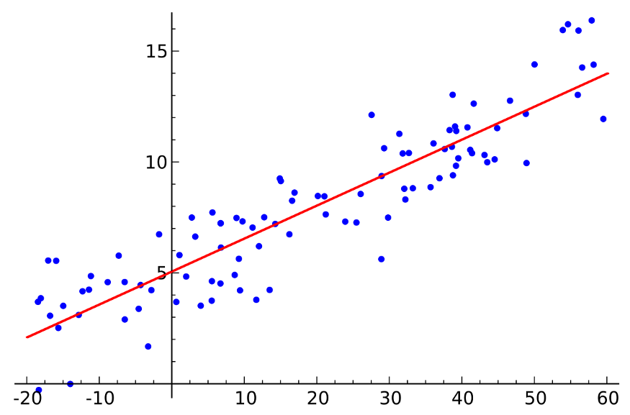

Types of Linear regression
1. Simple Linear Regression: In Simple Linear Regression, we try to find the relationship between a single independent variable (input) and a corresponding dependent variable (output). This can be expressed in the form of a straight line.
The same equation of a line can be re-written as:
Y represents the output or dependent variable.
β0 and β1 are two unknown constants that represent the intercept and coefficient (slope) respectively.
ε (Epsilon) is the error term.

Slide 6
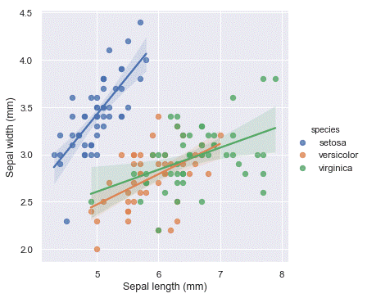
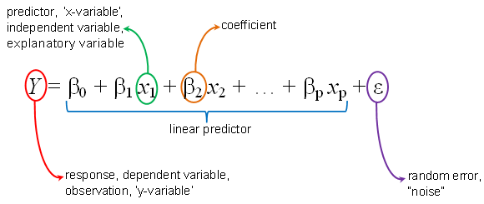
Types of Linear regression
2. Multiple Linear Regression: In Multiple Linear Regression, we try to find the relationship between 2 or more independent variables (inputs) and the corresponding dependent variable (output). The independent variables can be continuous or categorical.
The equation that describes how the predicted values of y is related to p independent variables is called as Multiple Linear Regression equation :

Slide 7
Steps involved:
Importing required Libraries
Importing the Dataset
Visualizing the data
Model Training
Predictions
Model Evaluation

Slide 8
Let’s Dive into jupyter notebook

Slide 9
The Sparks Foundation
Data Science & Business Analytics Intern
TASK – 1 : Prediction Using Supervised Learning (Linear regression)
Author : Sagar Kishore Dakua
Thank you Please post in the comment section for queries & suggestions

